Slide 1
Data Structure and Algorithms
(CS212)
Instructor : Syed Musharaf Ali
ROOM G-104-DSE IIUI
Ph# 051-9019724 Ext-2724
Email: musharaf.ali@iiu.edu.pk

Slide 2
STACK
A stack is an Abstract Data Type (ADT)
A stack is a collection of same data type items that follows the LIFO (Last In First Out) principle.
The addition of new items or the removal of existing items takes place at the same end.
The end of the stack is known as the top and the opposite is known as the bottom. The newest elements are near the top, and the oldest elements are near the base.

Slide 3

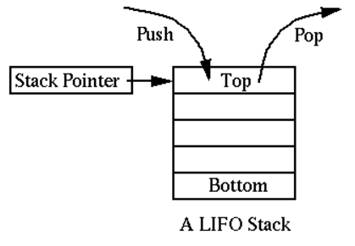
STACK
A stack can be implemented by means of Array, and Linked List.
Stack can either be a fixed size (Array implementation) or it may have dynamic resizing (Link list implementation).

Slide 4
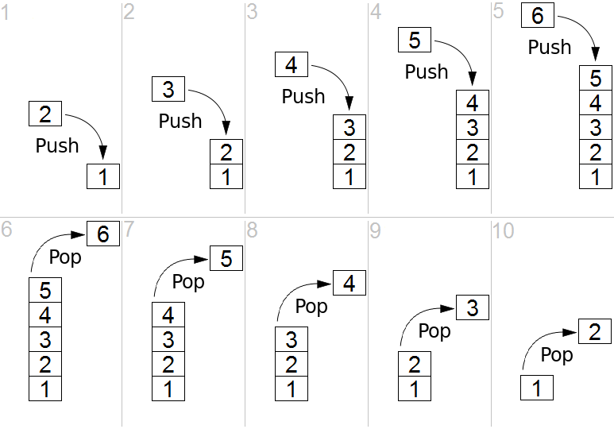
STACK-Operations
Push operation adds an element at the top
Pop operation removes an element from the top

Slide 5
STACK-Operations
Push Operation (Array implementation):
The process of putting a new data element onto stack is known as a Push Operation. Push operation involves a series of steps −
Step 1 − Checks if the stack is full.
Step 2 − If the stack is full, produces an error and exit.
Step 3 − If the stack is not full, increments top to point next empty space.
Step 4 − Adds data element to the stack location, where top is pointing.
Step 5 − Returns success.

Slide 6
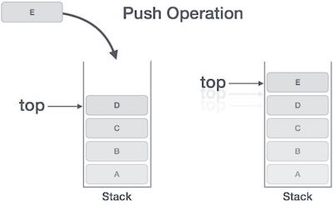
STACK-Operations
Push Operation:

Slide 7
STACK-Operations
Pop Operation:
Accessing the content while removing it from the stack, is known as a Pop Operation.
In an array implementation of pop() operation, the data element is not actually removed, instead top is decremented to a lower position in the stack to point to the next value.
In linked-list implementation, pop() actually removes data element and de-allocates memory space.

Slide 8
STACK-Operations
Pop Operation:
A Pop operation may involve the following steps −
Step 1 − Checks if the stack is empty.
Step 2 − If the stack is empty, produces an error and exit.
Step 3 − If the stack is not empty, accesses the data element at which top is pointing.
Step 4 − Decreases the value of top by 1.
Step 5 − Returns success.

Slide 9
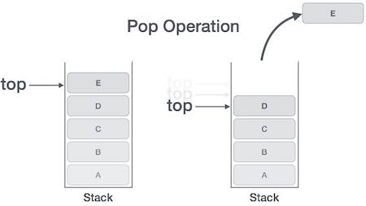
STACK-Operations
Pop Operation:

Slide 10
STACK-Operations
Time Complexity:
Time complexities for various operations that can be performed on the Stack data structure.
Push Operation : O(1)
Pop Operation : O(1)
Top Operation : O(1)
Search Operation : O(n)

Slide 11
STACK
Applications of Stack:
Parsing
Expression Evaluation
Expression Conversion
Infix to Postfix
Infix to Prefix
Postfix to Infix
Prefix to Infix
Towers of Hanoi
etc

Slide 12
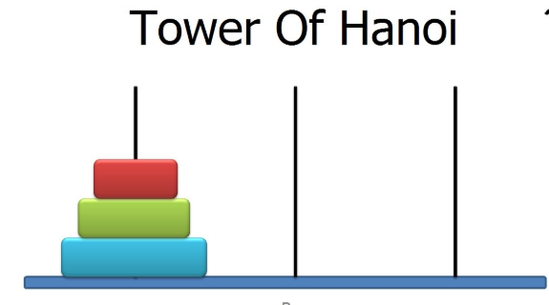
STACK
Applications of Stack:
https://www.mathsisfun.com/games/towerofhanoi.html

Slide 13
STACK (http://btechsmartclass.com/DS/U2_T5.html)
Expressions
An expression is a collection of operators and operands that represents a specific value.
Based on the operator position, expressions are divided into THREE types. They are as follows...
Infix Expression
Postfix Expression
Prefix Expression

Slide 14
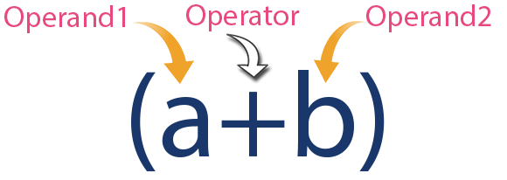
STACK
Infix Expressions
In infix expression, operator is used in between operands. The general structure of an Infix expression is as follows...
Operand1 Operator Operand2

Slide 15
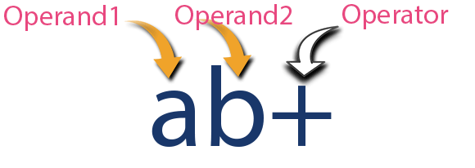
STACK
Postfix Expressions
In postfix expression, operator is used after operands. The general structure of Postfix expression is as follows...
Operand1 Operand2 Operator

Slide 16
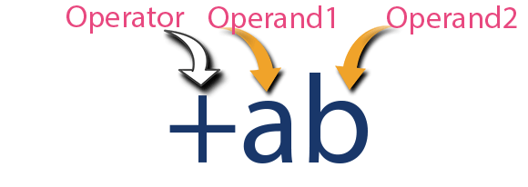
STACK
Prefix Expressions
In prefix expression, operator is used before operands.
The general structure of Pretfix expression is as follows...
Operator Operand1 Operand2

Slide 17
STACK
Infix to Postfix Conversion using Stack Data Structure
To convert Infix Expression into Postfix Expression using a stack data structure, We can use the following steps...
Read all the symbols one by one from left to right in the given Infix Expression.
If the reading symbol is operand, then directly print it to the result (Output).
If the reading symbol is left parenthesis '(', then Push it on to the Stack.
If the reading symbol is right parenthesis ')', then Pop all the contents of stack until respective left parenthesis is popped and print each popped operator to the result.
If the reading symbol is operator (+ , - , * , / etc.,), then Push it on to the Stack.
However, first pop the operators which are already on the stack that have higher or equal precedence than current operator and print them to the result.

Slide 18
STACK
Infix to Postfix Conversion using Stack Data Structure
Example : ( A + B ) * ( C - D )

Slide 19
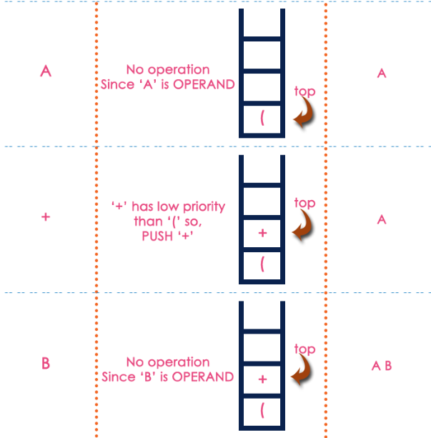
STACK
Infix to Postfix Conversion using Stack Data Structure
Example : ( A + B ) * ( C - D )

Slide 20
STACK
Infix to Postfix Conversion using Stack Data Structure
Example : ( A + B ) * ( C - D )

Slide 21
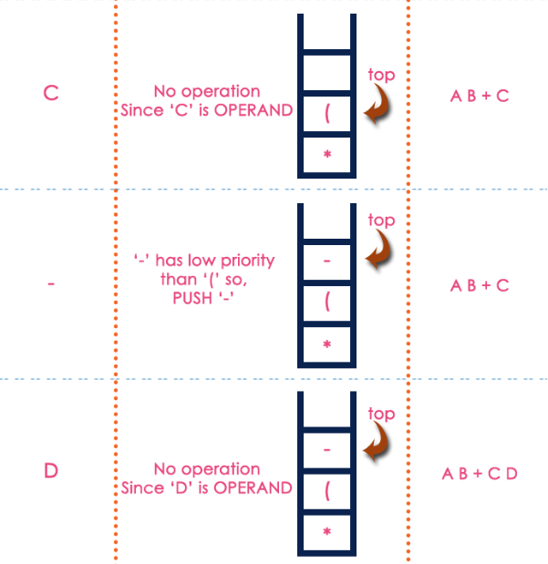
STACK
Infix to Postfix Conversion using Stack Data Structure
Example : ( A + B ) * ( C - D )

Slide 22
STACK
Infix to Postfix Conversion using Stack Data Structure
Example : ( A + B ) * ( C - D )
The final Postfix Expression is as follows...
A B + C D - *

Slide 23
STACK
Postfix Expression Evaluation using Stack Data Structure
A postfix expression can be evaluated using the Stack data structure. To evaluate a postfix expression using Stack data structure we can use the following steps...
Read all the symbols one by one from left to right in the given Postfix Expression
If the reading symbol is operand, then push it on to the Stack.
If the reading symbol is operator (+ , - , * , / etc.,), then perform TWO pop operations and store the two popped operands in two different variables (value1 and value2).
Then perform reading symbol operation using value1 and value2 and push result back on to the Stack.
Finally! perform a pop operation and display the popped value as final result.

Slide 24
STACK
Postfix Expression Evaluation using Stack Data Structure
Example: 5 3 + 8 2 - *

Slide 25
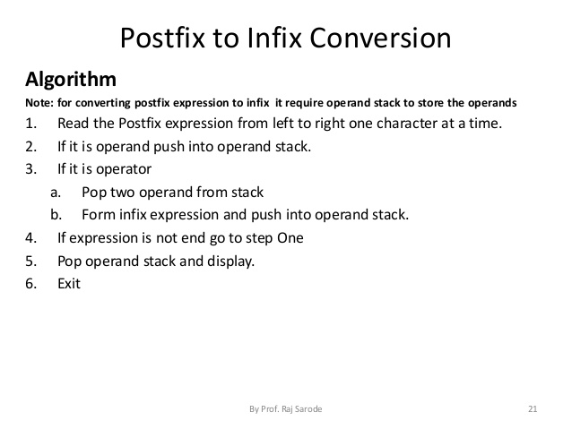
STACK

Slide 26
STACK
Infix to Postfix
Evaluate Postix
Postix to Infix
((2+2) * ((5-2) / ((2*2) - (6/3))))

Slide 27
STACK
Array implementation of Stack
Source : https://www.tutorialspoint.com/data_structures_algorithms/stack_program_in_c.htm
#include <stdio.h>
int MAXSIZE = 8;
int stack[8];
int top = -1;
int isempty() {
if(top == -1)
return 1;
else
return 0;
}

Slide 28
STACK
Array implementation of Stack
int isfull() {
if(top == MAXSIZE-1)
return 1;
else
return 0;
}
int peek() {
return stack[top];
}

Slide 29
STACK
Array implementation of Stack
int pop() {
int data;
if(!isempty()) {
data = stack[top];
top = top - 1;
return data;
} else {
printf("Could not retrieve data, Stack is empty.\n");
}
}

Slide 30
STACK
Array implementation of Stack
int push(int data) {
if(!isfull()) {
top = top + 1;
stack[top] = data;
} else {
printf("Could not insert data, Stack is full.\n");
}
}

Slide 31
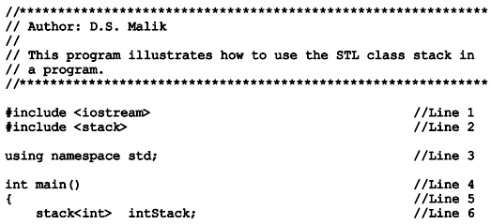
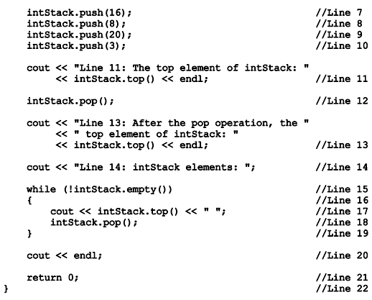
STL class stack

